Slide 1
The “Big Data” Ecosystem at LinkedIn
Presented by-
Linga Sai Yuvesh
Samhitha Tummanapalli
Sandeep
Shruthi Pinnamwar

Slide 2
Abstract
The use of large-scale data mining and has proliferated through some technologies such as Hadoop
This paper presents LinkedIn’s Hadoop-based analytics stack
The solution for “Last Mile” and providing a rich developer ecosystem
Solution is that these distributed system concerns are completely abstracted away from researchers.

Slide 3
What is “last Mile”?
In general terms it is dedicated to help the local retail stores to compete with today's technology driven economy.
Main goal: To make customers and retail stores closer by bridging between digital and physical world.

Slide 4
Introduction
Processing, Transforming and data learning for consumer web space.
LinkedIn is the Largest professional online social network with over 200 million members.
Filtering by people, job, company and other recommendations.
The rich development of environment.

Slide 5
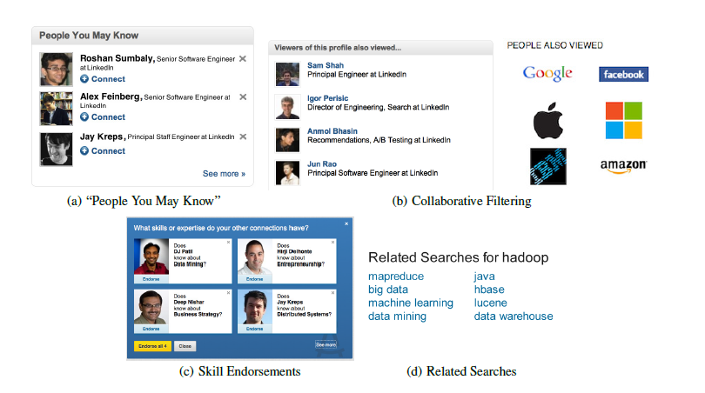

Slide 6
Intro(continue)
How can be this done?
These applications are largely enabled by hadoop.
The open source implementation of mapreduce.
Advantage of Hadoop?
Horizontal scalability
Fault tolerance
Multitenancy
Data flow is done by Kafka. And Azkaban is workflow schedular.

Slide 7
Kafka and Azkaban
Kafka: it is open-source streaming processing software platform developed by Apache. It is used for building real-time data pipeline and streaming app. It is horizontally scalable fault-tolerant wicked fast and runs in production in thousand of company.
Azkaban: is a open source workflow engine for hadoop ecosystem. It is a batch job scheduler allowing developer to control job execution in java and especially in hadoop projects.

Slide 8
Vehicles of transport in LinkedIn
Key Value Access : approximately 70%
Stream-Oriented Access : approximately 20%
Multidimensional or OLAP Access

Slide 9
Related work and comparing
Twitter developed a Pig.
Facebook uses Hive.
Yahoo uses Chukwa.
Here, In LinkedIn we use Kafka.

Slide 10
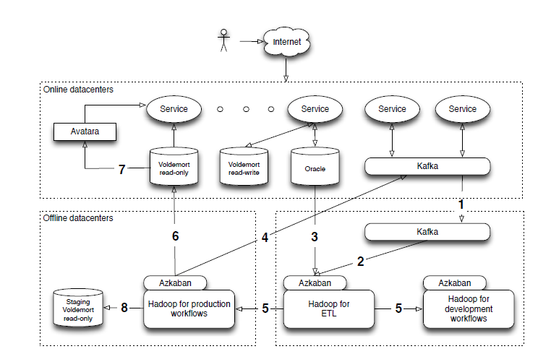
The ecosystem

Slide 11
Conti..
Before deploying data back to online, some workflow may push data to staging cluster with extra debugging information .
LinkedIn has been using HDFS.
One data is available into an ETL HDFS instance it is then replicated to two Hadoop instances one for development and other for production.
Shared in library which stores process of prototyping with our data, user-defined function is called DataFU.

Slide 12
INGRESS
Data in two forms:
Database data - information about users, companies, connections and other primary site data
Event data – stream of immutable activities or occurrences
Examples : logs of page views, search queries and clicks
Challenges:
Large datasets
Diverse data
Data schemas change rapidly
Monitoring and validating data quality

Slide 13

KAFKA
Distributed publish-subscribe system that persists messages in a write-ahead log, partitioned and distributed over multiple brokers.
Lets publishers to add records to a log called as a Topic.
Allows multiple subscribers as there are many different subscribing systems.
Zookeeper - highly available distributed synchronization service to redistribute load when number of consumers changes.

Slide 14

Data Evolution
Problem :
LinkedIn had to manually intervene to issue schema changes.
Solutions:
Load data streams in whatever form they appear such as unstructured data.
Challenge: Jobs that process have no guarantee on what may change in their feed. Might break any consumer data.
Manually map the source data to a stable schema and perform necessary transformations.
Challenge: Extremely difficult to manage thousands of data sources and data transformations.

Slide 15
LinkedIn’s solution for Data Evolution
Problems
Schema registry: Schema with each topic.
If data is published with incompatible schema, it’s rejected.
If the schema is compatible, it evolves automatically.
Check is done both at compile and runtime.
LinkedIn serialization format - Avro

Slide 16
Hadoop Load
Map-only job: Reads data from log for every topic and checks for any new topics.
Starts mapper tasks, evenly distributes the HDFS partitions, pulls data into partitions and registers with LinkedIn systems.
Runs every ten minutes on a dedicated ETL Hadoop cluster.
Load balancing is done.
Once data is available in ETL cluster, it is copied to production and development Hadoop clusters.

Slide 17
Continued…
Aggregator job: combines and dedups data daily into another HDFS location – reduces small files which reduces HDFS Namenode memory pressure.
Two Kafka clusters:
Primary: used for production and consumption.
Secondary: clone of the first cluster. Used for offline prototyping and data loading.
They are in sync via mirroring process supported by Kafka.

Slide 18
Some numbers…
Kafka maintains:
100TB of compressed data
300 Topics
15 billion writes each day
200 thousand messages per second
Dozens of subscribers
Delivers 55 billion messages each day

Slide 19
Monitoring
Audit trail is done by producers, brokers, consumers, Hadoop clusters.
Audit data contains:
Topic
Machine name
Logical processing tier the machine belongs to
Predetermined time window
Number of events seen by particular machine
This audit data is aggregated to check all events published reached all consumers.
Auditing is done continuously and alert is sent if completeness is not reached in time.

Slide 20
WORKFLOWS
The data stored on HDFS is processed by numerous chained MapReduce jobs that form a workflow, a directed acyclic graph of dependencies.
Workflows are built using a variety of available tools for the Hadoop ecosystem(Hive, Pig, and native MapReduce are the three primary processing interfaces)
To support data interoperability, Avro is used as the serialization format

Slide 21
Avro
Avro is a remote procedure call and data serialization framework developed within Apache's Hadoop project.
It uses JSON for defining data types and protocols, and serializes data in a compact binary format.
Its primary use is in apache hadoop, where it can provide both a serialization format for persistent data, and a wire format for communication between Hadoop nodes, and from client programs to the Hadoop services.
Over time, workflows implementing common functionality, could easily be extracted out as a library

Slide 22
Kafka

Slide 23
kafka
Apache Kafka is an open-source stream processing software platform developed by the apache software foundation written in scala and java.
aims to provide a unified, high-throughput, low-latency platform for handling real-time data feeds
Kafka stores key-value messages which come from arbitrarily many processes called "producers”
The data can thereby be partitioned in different "partitions" within different "topics". Within a partition messages are strictly ordered by their offsets
"consumers" can read messages from partitions.

Slide 24
Workflow cont
In the case of Hive, we create partitions for every event data topic during the data pull, thereby allowing users to run queries within partitions
A wrapper helps restrict data in Pig and native MapReduce, being read to a certain time range based on parameters specified
To manage these workflows, LinkedIn uses Azkaban, an open source workflow scheduler as these workflows can get fairly complex
LinkedIn maintains three Azkaban instances, one corresponding to each of our Hadoop environments

Slide 25
EGRESS
The result of these workflows are usually pushed to other systems, either back for online serving or as a derived data-set for further consumption
This is achieved by the workflows adding an extra job(consisting of a simple 1-line command for data deployment.) at the end of their pipeline for data delivery out of Hadoop.
There are three main mechanisms available depending on the needs of the application:
Key-value: the derived data can be accessed as an associative array or collection of associative arrays;
Streams: data is published as a change-log of data tuples;
OLAP: data is transformed offline into multi-dimensional cubes for later online analytical queries

Slide 26
Key-Value
Key-value is the most frequently used vehicle of transport from Hadoop at LinkedIn and is made possible by the use of Voldemort.
Voldemort is a distributed key-value store akin to Amazon’s Dynamo with a simple get(key) and put(key, value) interface.
Voldemort was initially built for read-write traffic patterns with its core single node storage engine using either MySQL or Berkeley DB (BDB)

Slide 27
Initial prototype would build MyISAM, one of the storage engines of MySQL , database files on a per-partition basis as the last MapReduce job in a workflow, and then copy the data over into HDFS.
Voldemort would then pull these files into a separate store directory and change the “table view” serving the requests to the new directory (not scalable due to copy cost)
introduced a custom storage engine tailored to HDFS to solve the copy problem (chunk set)

Slide 28
The index file is a compact structure containing a hash of the key followed by the offset to the corresponding value in the data file
A MapReduce job takes as its input a dataset and finally emits these chunk sets into individual Voldemort node-specific directories
On the Voldemort side, configurable number of versioned directo- ries are maintained on a per-store basis with just one version serving live requests while others acting as backups
After generating new chunk sets on Hadoop, Voldemort nodes pull their corresponding chunk sets in parallel into new versioned directories

Slide 29
Voldemort can throttle the data being fetched. A check is also performed with pre-generated check- sums to verify integrity of pulled data
chunk set files of the current live directory are closed and the indexes in the new chunk sets are memory mapped, relying on the operating system’s page cache
This complete chunk generation, pull, and swap operation is abstracted into a single line Pig StoreFunc that is added by the user to the last job of their workflow

Slide 30
Streams:
The second outlet for derived data generated in Hadoop is as a stream back into Kafka
useful for applications that need a change log of the underlying data implemented as a HadoopOutputFormat
data is published as a change-log of data tuples
script to push a stream of session-based page-views
sessions = FOREACH pageviews GENERATE Sessionize(*);STORE sessions INTO ’kafka://kafka-url’ USINGStreams(’topic=SessionizedPageViewEvent’)

Slide 31
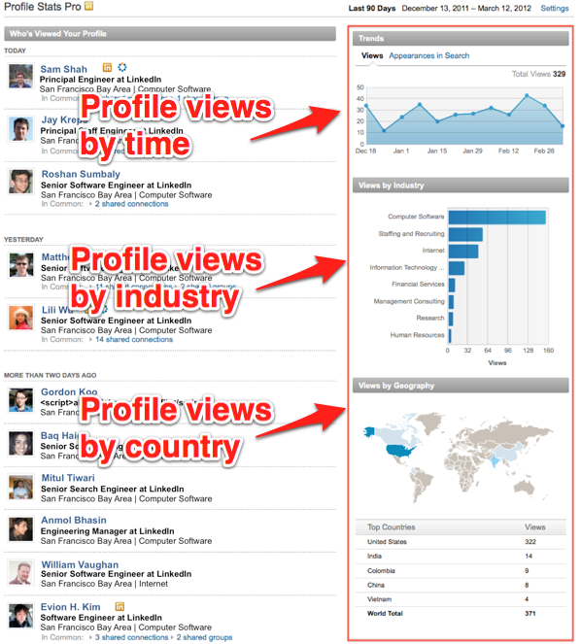
OLAP: data is transformed offline into multi-dimensional cubes for later online analytical queries..
LinkedIn has many analytical insight products such as "Who's Viewed My Profile?“ and "Who's Viewed This Job?".
these are multidimensional queries. For example, "Who's Viewed My Profile?" takes someone's profile views and breaks them down by industry, geography, company, school, etc to show the people who viewed their profiles
Problem: A system that can answer these queries in milliseconds across 175+ million members.
Reference:https://engineering.linkedin.com/olap/avatara-olap-web-scale-analytics-products

Slide 32
Avatara:
Avatara is LinkedIn's scalable, low latency, and highly-available OLAP system for "sharded" multi-dimensional queries in the time constraints of a request/response loop. It has been successfully powering "Who's Viewed My Profile?" and other analytical products
Avatara consists of two components:
An offline engine that computes cubes in batch
An online engine that serves queries in real time
Notes:
he offline engine computes cubes with high throughput by leveraging Hadoop for batch processing. It then writes cubes to Voldemort, LinkedIn's open-source key-value store. The online engine queries the Voldemort store when a member loads a page

Slide 33
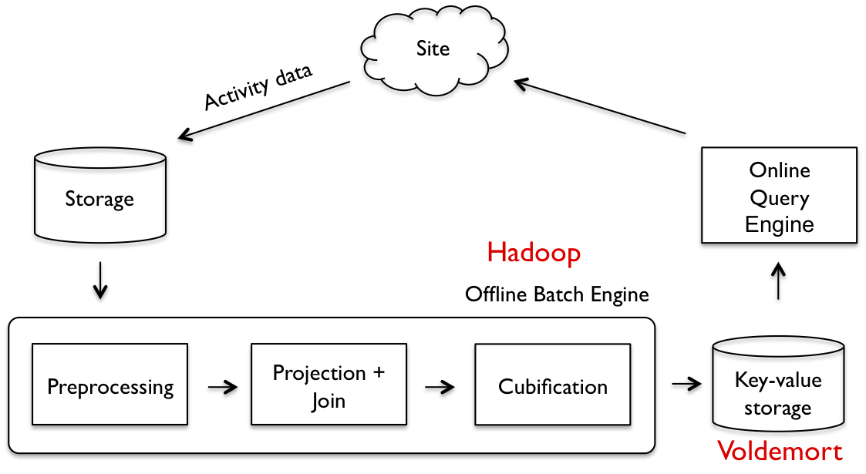
The pipeline preprocess raw data as needed
Projects out dimensions of interest,
Performs user-defined joins,
Transforms the data to cubes
The result of the batch engine is a set of sharded small cubes, represented by key-value pairs
The online query engine retrieves and processes data from Voldemort, returning results back to the client.
Reference:https://www.linkedin.com/pulse/reinventing-people-you-may-know-linkedin-mitul-tiwari/

Slide 34
APPLICATIONS
Most features at LinkedIn rely on this data pipeline either explicitly(data being the product), or implicitly (derived data infusing into the application).
Many applications use Kafka ingress flow and use Azkaban as their workflow and dependency
Key-value
egress mechanism from Hadoop. Key-value access using Voldemort is the most common
Over 40 different products use this mechanism and it accounts for approximately 70% of all Hadoop data deployments at LinkedIn

Slide 35
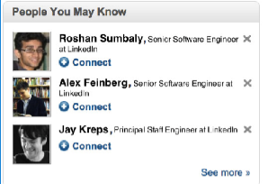
People You May Know (PYMK): Recommends other people to connect with allowing members to grow their network The two main challenges in building are: Machine learning Scale
In terms of machine learning,
the basic problem behind PYMK is link prediction over social graph
Solutions: friends-of-friends or triangle closing

Slide 36
In terms of scale,
PYMK system daily processes 100s of terabytes of data, 100s of billions of potential connections, and pushes new PYMK results every day.
Keep optimizing PYMK system to deal with such high growth in data processing while keep refreshing PYMK results every day
Solution:
LinkedIn has built an ecosystem of big data for addressing scaling challenges in PYMK including many systems such as Voldemort key-value store, Azkaban Hadoop workflow management, Apache Kafka for streaming, for simplifying data processing in Hadoop PIG, Cubert for efficient joins and data processing, etc.

Slide 37
Azkaban helps manage the size and complexity of this workﬂow by dividing into sub workflows
managed by Azkaban
conducts numerous split tests to
test the workﬂow on the development Hadoop grid, publish the new workﬂow into the executing system
push a key-value store where the key is a member identiﬁer and the value is a list of member id, score pairs
Kafka retrieves by a simple get, applies business rules
Azkaban Hadoop workflow management,
Voldemort key-value store
Apache Kafka for streaming,

Slide 38

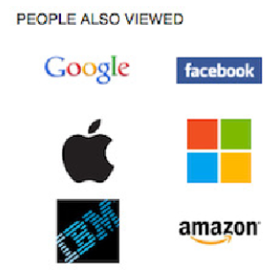
Collaborative Filtering: Co-occurrence or association rule mining
LinkedIn’s frontend framework emits activity events on
every page visit as part of LinkedIn’s base member activity
tracking.
uses these events to construct a co-occurrence matrix with some entity speciﬁc tuning
This matrix is partially updated periodically depending on the needs
The resulting key-valuestore is a mapping from an
entity pair—the type of the entity and its
identiﬁer — to a list of the top related entity pairs

Slide 39
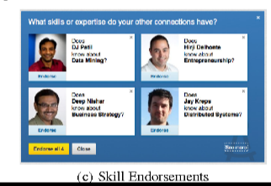
Skill Endorsements: where a member can afﬁrm another member in their network for a skill
A workﬂow ﬁrst determines skills that exist across the memberbase
which is a deep information extraction problem
synonym detection
disambiguation
Solution : Another joins proﬁle, social graph, group, and other activity data to determine the skills for a member
These are pushed as a key-value store
Resulting recommendations are delivered as a key-value store mapping a member id to a list of member, skill id, and score triples

Slide 40
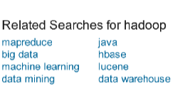
Related Searches :
provide an important navigational aid for improving members’ search experience in ﬁnding relevant results to their queries.
The search backend emits search activity events and the resulting store is keyed by search term

Slide 41
Thank you!

